Slide 1
Certified Cargo Screening Program
Non-SSI Presentation

Slide 2
Agenda
Opening Remarks
Sensitive Security Information (SSI) Review
100% Screening Legislation
Certified Cargo Screening Program (CCSP)
Phase One Deployment
CCSP Requirements
Next Steps
Q & A

Slide 3
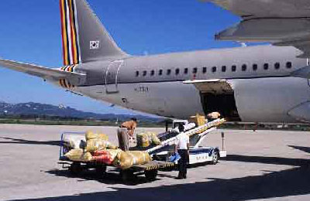
100% Screening Requirement
Background
President Bush approved Implementing Recommendations of the 9/11 Commission Act of 2007 on August 3, 2007.
The legislation mandates 100% screening by August 2010 and requires TSA to:
Establish a system to screen 100% of cargo transported on passenger aircraft.
Provide a level of security commensurate to that of passenger baggage.
Meet inspection benchmarks.
Congressionally Mandated Cargo Screening Benchmarks
9/11 Act
50%
100%
August 2007
February 2009
August 2010

Slide 4
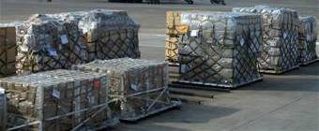

100% Screening Requirement
Impacts
All cargo must be screened at the piece level by TSA-approved methods prior to being loaded on a passenger aircraft.
Screening capacity at a single point in the supply chain is not sufficient enough to accomplish this requirement.
Significant carrier delays, cargo backlogs, and transit time increases are expected.
~12 million pounds moves on PAX daily.
Cargo must be broken down to piece level and screened by piece.
August 2010
100% Screening Required by Congress
Notes:
12 million lbs passenger luggage

Slide 5
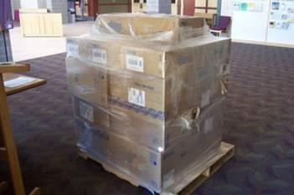
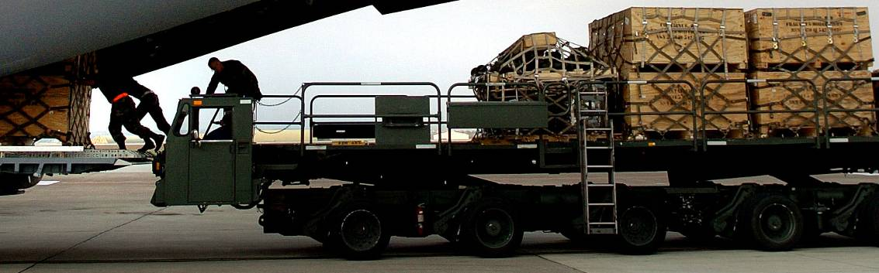

Piece Level Cargo
Piece level cargo is the individual item within a shipment. The number of pieces is determined by the number of pieces identified by the shipper-level documentation.
By February 3, 2009, all cargo must be broken down and 50% of the individual pieces must be screened prior to being loaded on a passenger aircraft.
By August 3, 2010, cargo must be 100% screened at the piece level.
Notes:
\

Slide 6
Future Air Cargo Supply Chain
In the future, screening responsibility will be allocated across the supply chain.
Risk Assessment
Freight Forwarder
**Screening
Known Shipper
Air Carrier
United States Air Cargo
Distribution by Weight*
**Screening
100%
Screened
All-Cargo Aircraft
88%
Passenger Aircraft
12%
CCSF: Freight Forwarder
**Screening
CCSF:
Shipper / 3PL / Manufacturer
(Known Shipper)
Notes:
**Screening must occur prior to consolidation. Screening methods: electronic, manual, and canine.
Freight Forwarder
Ensure chain of custody
Notes:
Key Talking Points/Items to remember here:
Currently, only air carriers screen cargo.
There isn’t sufficient capacity at one single point (air carrier) in the supply chain to handle the amount of cargo that may need to be screened (~ insert Doug’s statistic ~600-700,000 pieces a day based on estimated 15M pounds of cargo daily moving PAX)
Big delsy

Slide 7
Certified Cargo Screening Program

Slide 8



Certified Cargo Screening Program Background
The Certified Cargo Screening Program (CCSP) is a key component of TSA’s approach to enable industry to achieve 100% screening while still allowing for the flow of commerce.
TSA developed the philosophy behind CCSP by working closely with U.S. and international agencies and associations to incorporate key aspects of commensurate security programs:
Current Security Programs
C-TPAT
TSA’s Certified Cargo
Screening Program
U.K. Known Consignor Program
Ireland Known Consignor Program

Slide 9
Certified Cargo Screening Program Overview
The Certified Cargo Screening Program (CCSP) is a facility based program.
CCSP was developed to:
Allow screening of cargo early in the air cargo supply chain by a trusted, vetted, and audited facility.
Establish the integrity of a shipment through enhanced physical and personnel security standards at Certified Cargo Screening Facilities (CCSFs).
Maintain the integrity of a shipment throughout the supply chain by utilizing stringent chain of custody methods.
Participation in CCSP is voluntary, but once in, CCSFs must:
Adhere to increased TSA-directed security standards.
Share responsibility for supply chain security.
Employ chain of custody.
Permit onsite validations.
Be subject to TSI-C inspections.
Notes:
Key Talking Points/Items to remember here:

Slide 10
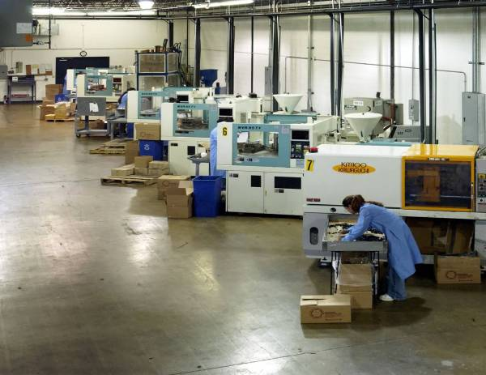
Who can become a Certified Cargo Screening Facility?
Facilities screening under the CCSP will be known as Certified Cargo Screening Facilities (CCSFs).
Facilities currently applying to become Certified Cargo Screening Facilities:
TSA will permit independent facilities (ICSFs) to screen cargo for other entities.
Any entity with a desire to screen cargo must have a facility that can be secured.
CCSFs must be no more than one node back from a currently regulated entity (freight forwarder/air carrier).
Facilities that are not currently regulated by TSA will become regulated under the program.
Shipping
Facilities
Manufacturing Facilities
Third Party Logistics Providers
Warehouses/ Distribution Centers
Contract Manufactures
Warehouses
Freight Forwarding
Facilities
Notes:
Key Talking Points/Items to remember here: (all cargo carriers?)
“ One node back” for example ABC Company may have cargo moving in many lanes through IACs and 3PLs.
Only cargo that is tendered directly to the IAC/AC may be counted as screened.

Slide 11
Phase One Deployment

Slide 12
Phased Approach
A phased approach allowed program deployment and development to occur in parallel.
Determine Cities &
Facilities
Initiate Simple Scenarios
Evaluate &
Refine Program
Introduce Complexity
Evaluate & Refine Program
Expand Program
Full Rollout
Early 2009
Phase One Deployment
10 to 15 companies/facilities per city.
Initially targeted three airports and expanded as program developed.
Team of 9 experienced TSA Field Staff.
Phase One was rolled out at a total of nine cities.
Open to all cargo and business complexities.
Third Party Validators are phased in to replace TSA Field Teams.
All air carriers recognize CCSF screening.

Slide 13
CCSP Phase One Process
TSA is working collaboratively with participants throughout the supply chain to learn best practices and refine overall CCSP standards for full rollout.
Conduct Outreach to Identify Participants
Initial Site Visits & Meetings
TSA Issues Final Order
Exploratory/Implementation Period
Finalize Order
TSA Review
Application
CCSP Screening
Issue Draft Order & AP to Participants
Upon Application Approval:
Facility Audits Conducted
TSA Issues Certification
Compliance Begins
Refine Facility Standards & Application
Mock Cargo Moving
(1 ½ to 2 months)
Facilities in the “exploratory” phase are working with TSA to provide feedback on their ability to uphold facility standards, “mock screen” cargo, employ chain of custody, and tender/receive cargo as screened.
Feedback on all aspects of the program should be provided to TSA.
Notes:
Key Talking Points/Items to remember here:
Focus on the mock processes and a collaborative approach.

Slide 14
CCSP Status Update
Round One: (San Francisco, Chicago, Philadelphia)
Initial outreach began in September 2007, formal outreach January/February 2008
All Phase one cities currently in the exploratory and implementation phase.
Round Two: (Los Angeles, Dallas, New York/Newark)
Conducted initial outreach forums March 24, 2008 – April 4, 2008.
Round Three: (Seattle, Atlanta, Miami)
Initial outreach forums conducted May 5, 2008 – May 9, 2008.
SEA
WEST
JFK
ORD
PHL
EWR
SFO
Key
CENTRAL
EAST
LAX
CCSP Phase One
ATL
DFW
MIA
Notes:
Key Talking Points/Items to remember here:
TSA has received 113 applications to be CCSFS
Phase One Objectives
10 to 15 facilities per city
Target three airports initially and expand as program develops
Introduce cargo complexities
Participation based on facility and TSA approval
TSA will be modifying the program from information gathered in SFO.
You are lucky to be here participating to have an opportunity to help shape a program that will have a big impact on industry as a whole.

Slide 15
Regional CCSP TSA Contacts
Western Region | Central Region | Eastern Region
San Francisco Marilyn Christiansen Marilyn.Christiansen@dhs.gov Los Angeles Alida Offenbach Alida.Offenbach@dhs.gov Seattle Robert Shaffer Robert.Shaffer@dhs.gov | Chicago Carl Trombatore Carl.Trombatore@dhs.gov Dallas Ruth Porrata Ruth.Porrata@dhs.gov Atlanta Yvette Jamison Yvette.Jamison@dhs.gov | Philadelphia Darryl Hines Darryl.Hines@dhs.gov New York/Newark Don Basso Donald.Basso@dhs.gov Miami Henry Murray Henry.Murray@dhs.gov

Slide 16
CCSP Standards

Slide 17
CCSP Program Standards
During Phase One:
Non-regulated entities will operate under a regulatory Order issued by TSA.
Freight forwarders and air carriers will operate under Alternate Procedures (APs) to their standard security programs (SSPs).
At full rollout, all CCSFs will operate under the Certified Cargo Screening Standard Security Program (CCSSSP).
O
R
D
E
R
M
S
P
I
A
C
S
S
P
A
O
S
S
P
F
A
C
A
O
S
S
P
Certified Cargo Screening Standard Security Program

Slide 18
Chain of Custody Requirements
A Certified Cargo Screening Facility must adhere to the chain of custody (CoC) process in order to prevent or deter the introduction of unauthorized explosives, incendiaries, and other destructive substances or items into screened cargo.
The chain of custody process must be initiated immediately upon screening and prior to screened cargo leaving the Designated Screening Area (DSA).
A CCSF must adhere to the chain of custody process until the cargo is tendered to another CCSF, IAC, aircraft operator or air carrier.
Shipper’s Compliance Responsibility
Access Control Area
PAX Cargo
Order Picking
Order
CoC
Apply Method
Received by
Packing
/
Method
(
TET or Process
)
Freight
Screening
Forwarder
DSA
Decision is made that cargo will go PAX
TSA-approved Chain of Custody
Freight Forwarder’s Compliance Responsibility

Slide 19
Participating in Phase One

Slide 20
Your Role in Phase One Deployment
Shippers
(MFG/WHS/3PL/DC)
Become a Certified Cargo Screening Facility (CCSF) and agree to become a regulated entity.
Adhere to the security standards provided in the regulatory Order.
Provide feedback to TSA to improve, revise, and shape future of program.
Shipper (MFG/WHS/3PL/DC)
Freight Forwarders
Nominate shippers to participate in Phase One.
Participate as a supply chain partner and adhere to the IAC SSP Alternate Procedures.
Become a CCSF and screen cargo.
Provide feedback to TSA to improve, revise, and shape future of program.
Air Carriers
Participate as a supply chain partner and adhere to the AOSSP Alternate Procedures.
Provide feedback to TSA to improve, revise, and shape future of program.
Assist in educating freight forwarders and shippers on enormity of issue.

Slide 21
CCSP Phase One Considerations
Cost Factor
Considerations
Cargo Configuration
100% screening must occur at the piece level. Consolidated cargo will be broken down at the freight forwarder/air carrier.
Cost of Cargo Delays
Significant delay times are expected if 100% screening remains at the air carrier only.
Screening Fees
TSA expects that market forces will dictate a range of additional screening fees for services offered by supply chain entities.
Program Application
There are no costs associated with submitting an application to CCSP.
Program Validation
During Phase One, validations will be performed by TSA. Market forces will determine validation costs by a third party auditor at full rollout.
Implementing CCSP Standards
TSA utilized existing security programs to build the required standards for CCSP. C-TPAT certified facilities may only need minor upgrades.
Personnel Standards
TSA will cover the costs of STAs for shippers in Phase One Deployment. At full rollout of the program, the cost for each STA will be incurred by the facility.
Notes:
Key Talking Points/Items to remember here:
May need to add in the risk cost factor of cargo being reopened and screened later on in the supply chain.

Slide 22
CCSP Benefits
The benefits of participating in the Certified Cargo Screening Program may outweigh costs carried by the facility in meeting program guidelines.
CCSF Benefits
CCSP:
Decreased log jams (carrier delays) and expedited supply chain flow.
Ability to build bulk configurations.
Ability to continue to ship certain cargo types without potential invasive screening later on in the chain.
Phase One:
Provide feedback on the structure and content of the program.
Facility validations will be conducted by TSA at no cost to the participating facility.
There are no fees associated with Security Threat Assessments (STAs) for shippers during Phase One.
CCSF Costs
Implement facility and chain of custody standards*.
Facility audits.
*Facility Standards include physical access controls, personnel, procedural, physical, and information technology security.

Slide 23
CCSP Phase One Participation
Steps to join the CCSP during Phase One:
Contact CCSP@dhs.gov for a CCSF application.
Submit application and all applicable Sensitive Security Information Handling Requirements.
TSA will determine your eligibility for Phase One.
Once eligible, a TSI-C in your region will work with you on a collaborative basis to meet facility standards and program requirements.
Undergo CCSP validation, at no charge.
Sign Order.
Receive Facility Certification from TSA HQ.

Slide 24
In Summary
The 50% and 100% milestones are fast approaching, congressionally mandated, and therefore not flexible.
TSA will enable secure, audited, and certified facilities to screen cargo further upstream in the air cargo supply chain.
Collaboration is essential through Phase One Deployment for CCSP to be effective.
CCSP Phase One presents an opportunity to get into the program early.
Tamper evident technologies and chain of custody are critical elements of CCSP.
CCSP is a voluntary program and may not be applicable to all facilities.

Slide 25
Q & A
Additional questions may be emailed to CCSP@dhs.gov.

