Slide 1
Tactical and Strategic Risks from Disruption of Global Supply Chains
Wallace Hopp
University of Michigan
Seyed Iravani, Zigeng Yin
Northwestern University

Slide 2
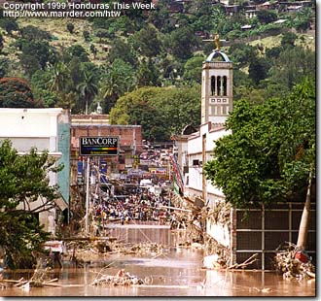
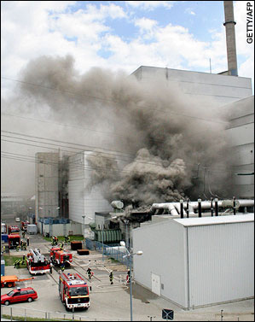
Supply Chain Disruptions
Taiwan earthquake (1999)
Dramatic impact on the global semiconductor market
Hurricane Mitch (1998)
Caused catastrophic damage to banana production
Philips’ plant fire (2000)
Great business impact on Ericsson
Each of these had strategic consequences for a market…
Notes:
Main reference(s) on the Taiwan earthquake: (1) Earthquake in Taiwan. Category: Editorial by FastSite [09/28/1999 | 12:00 AM] & (2) Annual reports of AMD and Intel.
Main reference(s) on the Hurricane Mitch: Annual reports of Chiquita and Dole.
Main reference(s) on the Philips fire: (1) Sheffi, Y. 2005. The Resilient Enterprise: Overcoming Vulnerability for Competitive Advantage. MIT Press, Cambridge, Massachussets. & (2) Gartner press releases www.gartner.com.
A number of current business trends increase the vulnerability to supply chain disruptions:
-- globalization
-- outsourcing
-- lean
which can be caused by a variety of natural and man-made events.

Slide 3

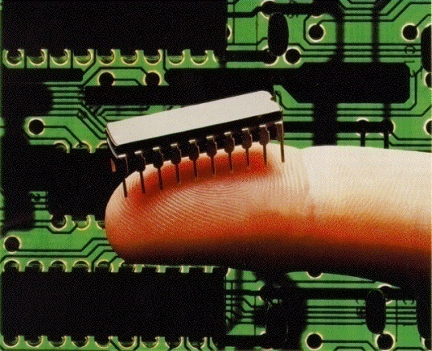
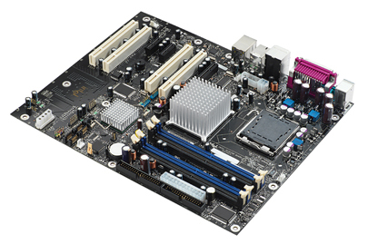
Taiwan Earthquake: Intel vs. AMD
AMD released the Athlon K7 in August 1999, giving it an edge over Intel’s leading Pentium III and positioning it to gain market share
In September 1999, the Taiwan earthquake shut off motherboard shipments for weeks.
All AMD Athlon motherboard facilities were located in Taiwan, while Intel had another Pentium III motherboard facility in Korea, which was sourcing semiconductor from Korean suppliers.
AMD missed a golden opportunity to gain market share.
Notes:
AMD released the Athlon K7 in August 1999, giving it a substantial performance edge over Intel’s market leading Pentium III. They were poised to pick up market share. But the earthquake caused an abrupt shutoff of motherboard supplies, hurting AMD’s sales and allowing Intel more time to get a competitive product on the market. The disruption almost certainly cost AMD market share it would have gained otherwise.

Slide 4
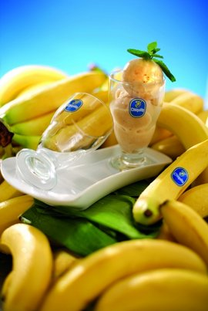

Hurricane Mitch: Chiquita vs. Dole
sdfjkfjklfd
Estimated shares of transnational companies in world banana market 1995-1999
 | 1995 | 1997 | 1999
Dole | 22-23 | >25 | 25
Chiquita | >25 | <25 | 25
Del Monte | 15-16 | 16 | 15
Hurricane Mitch (Oct. 1998) struck Honduras and destroyed at least 70% of crops, including 80% of the banana crop.
Dole lost 70% of their supply and suffered a 4% decline in revenue for the 4Q of 1998.
Chiquita was able to increase output from its alternate suppliers in areas not affected by the hurricane, so it wound up with an revenue increase of 4% in the 4Q of 1998.
The hurricane helped Chiquita reverse a market share decline.
Notes:
The banana price crisis of the 1990s was due to an imbalance between a static demand and a growing supply.
World banana prices fell markedly in the first half of the 1990s, especially in Europe, and partly recovered in 1998 as supply was curtailed by adverse climatic conditions in Latin America (heavy rains and flooding caused by the El Niño phenomenon in Ecuador, hurricane Mitch in Honduras and Guatemala). However, prices fell again in 1999 and reached record-low levels in 2000 as the gap between supply and demand widened.
Chiquita benefited from the disruption at the expense of Dole and gained market share.

Slide 5



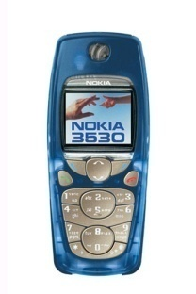
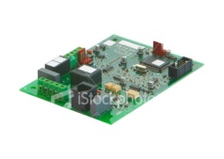

Phillips Fire: Nokia vs. Ericsson
Fire in
Philips’ Plant
Nokia
End of
Outage
Motorola
Ericsson
Global Mobile Market Share from 1997 to 2004. (Gartner 1999-2006)
Notes:
March 2000, a brief fire in Philips semiconductor plant interrupted supply of RF chips to both Nokia and Ericsson.
The impact on Ericsson was vastly greater than that on Nokia. Why did Nokia survive the disruption better?
Samsung also reported an increase in market share, while Motorola’s loss of market share decreased after the disruption. So, it is reasonable to conclude that, during the outage, some customers of Ericsson (and possibly Nokia) shifted to Samsung (and possibly Motorola).

Slide 6
Supply Chain Risks
Disruption of component supplies present both:
Tactical Risk – Short-term loss of sales revenue due to inability to fill orders or replenish stocks.
Strategic Risk – Loss of market share due to customer shifts that affect sales beyond the disruption event.
If strategic risks are substantial, firms may under-invest in mitigation by focusing only on tactical risks.

Slide 7

Mechanisms for Market Share Effects
Nintendo supply chain unable to meet demand for hot selling Wii in 2007:
Some customers buy Sony PS3 as holiday gifts instead, increasing the pool of people likely to buy Sony in the future.
Smaller sales means less incentive for suppliers to produce games for Wii, which further reduces future sales.

Slide 8
Magnitude of Strategic Risk
Hendricks & Singhal (2005) found:
In the year leading up to a reported a supply chain disruption, firms experienced
107% drop in operating income (profit)
114% drop in return on sales
93% reduction in return on assets
6.9% lower sales growth
relative to a control group of firms of similar size in similar industries
These numbers did not improve for two years after the announcement.
Hendricks, K., V. Singhal. 2005, Association Between Supply Chain Glitches and Operating Performance, Management Science 51(5), 695-711.
Notes:
The reason numbers were down (relative to control group, not necessarily in absolute value) prior to the announcement is that the problem has already occurred.
A possible explanation for the prolonged impact is that lost sales during the disruption are associated with loss of customer goodwill relative to the competition, which translates into loss of market share beyond the event itself.

Slide 9
Research Questions
How to prepare for an unlikely but severe disruption?
How to respond to a disruption when it occurs?
How to measure a firm’s risk exposure?
How to reduce supply chain risks from disruptions?

Slide 10
Basic Model – Duopoly with Third Party
Before Disruption
After Disruption
We assume:
First-come-first-serve for securing backup supply.
Business-to-business environment (must serve own customers first)
Unserved customers of Firm A buy from Firm B (or Firm C if Firm B lacks supply).
Customers who switch firms during disruption remain switched afterward with probability given by customer loyalty coefficient.
Normal
Supply
Firm A
Normal
Supply
Firm A
Backup
Capacity
Firm B
Backup
Capacity
Firm B
C
The Third
Party
C
The Third
Party

Slide 11
Firms’ Parameters
Profitability of A: r_{A}
Final Assembly Capacity of A: K_{A}
NPV of unit of market share of A: m_{A}
A’s Customer Brand Loyalty to B: γ_{AB}
A’s Customer Brand Loyalty to C: γ_{AC}
Firm A
Duopoly Market
Demand of A
per unit time: d_{A}
Backup
Capacity
Firm A
Demand of B
per unit time: d_{B}
Firm B
Available Backup Capacity: S
Premium for Unit of Backup Capacity: c
Firm B
Profitability of B: r_{B}
Final Assembly Capacity of B: K_{B}
NPV of unit of market share of B: m_{B}
B’s Customer Brand Loyalty to A: γ_{BA}
B’s Customer Brand Loyalty to C: γ_{BC}

Slide 12
Customers’ Behaviors
During the outage, customers of Firm A who are unable to purchase from Firm A will buy the product (without hesitation) from Firm B, as long as Firm B can provide substitute products. While, the third party, Firm C, offers a less-than-perfect substitute for the products offered by Firms A and B, which customers may turn to if neither Firm A nor Firm B have supply available.
However, whether a customer will switch permanently depends on his/her brand loyalty. We model the brand loyalty of Firm A’s customer by the length of time that customers of Firm A wait during the disruption before they permanently switch to the other firm’s (B and/or C) product.

Slide 13
Two-level Decisions
Each firm has two levels of decisions to make:
How much to invest in preparedness?
Advanced Preparedness Competition (APC)
How much backup capacity to purchase from the shared backup supplier in the event of a disruption?
Backup Capacity Competition (BCC)
To compute these decisions:
(a) use a non-cooperative game to model the competition “to be first”;
(b) assume that firms maximize expected profit (short-term sales profit + profit from a long-term shift in market share).
Notes:
Why “expected profit” given you consider “low probability” events?
-- We are not talking about individual event. We talk about the consequence. We pull all possible risks together so that the likelihood of having a disruption becomes not so small.
-- Under the B2B environment, it is reasonable to assume the manager cares more about the expected profit than the worst scenario.
We use a non-cooperative game to model the competition to be first to secure the shared backup capacity
we assume that firms maximize expected profit, which includes both short-term sales profit and the profit from a long-term shift in market share
Detection Capacity -- such as, ability to quickly identify the occurrence of a disruption and means for rapidly contacting possible backup supplies after the disruption happens.

Slide 14
Four-stage Process
Outage
Pre-Disruption
Backup Capacity
Fixed Lead Time
Production during
Remaining Outage
After
Outage
Total
Profit
Advanced
Preparedness
Competition
Backup
Capacity
Competition
Firm A
Total
Profit
Time
Tactical Risk
Strategic Risk
Firm B
Backup Capacity
Comes On Line
Disruption Occurs
Outage Ends
Time
Notes:
Production during Remaining Outage:
(Exclusive suppliers of each firm is coming on-line.) At the same time, the allocation of the shared backup supplier, which had been determined as the BC Competition result, is also coming on-line.
After Outage:
Market share is redistributed according to the customer brand loyalty.

Slide 15
Backup Capacity Competition (BCC)
There are only five possible outcomes of the BCC:
Winner protects: buys only enough supply for its customers, or as much as is available
Winner is aggressive: buys full backup supply to poach customers from loser
Winner forfeits: doesn’t buy backup supply even though it has the option
Loser forfeits: doesn’t buy backup supply even if some is available
Both firms forfeit: neither buy backup supply

Slide 16
Optimal strategy depends on profit margins, as well as amount of backup supply, customer loyalty coefficients, production capacities, etc.
Profit Margin
of Firm B
A is Aggressive
A Forfeits to B
A Protects
B Forfeits to A
A & B Forfeit
0
Profit Margin
of Firm A

Slide 17
Advanced Preparedness Competition (APC)
We assume:
and can show that a unique Nash equilibrium exists that describes the amount each firm will invest in preparedness.

Slide 18
Using the Model to Characterize Risk Exposure
Definition: Firm i’s Loss due to Lack of Preparedness (Ω_{i}) is the difference between Firm i’s expected profit if it made strategic preparation in the Advanced Preparedness Competition and if it did not.
Evaluation of Risk (as measured by Ω_{i}):
Create a large sample of scenarios covering the majority of situations we could observe in practice.
Use regression analysis to generate a statistical relation between Ω_{A} and various factors.
Notes:
Regardless of whether a firm prepares or not, we assume that the rival firm does prepare. Therefore, when Firm i does not prepare, it usually winds up being the Follower in the BC Competition.
Note that since we are assuming model parameters are known, we can compute Ω_{i} exactly. However, it involves solving an optimization, so we do not have a closed form expression for it. This is why we use a large set of numerical examples, coupled with regression analysis to get a sense of what factors drive risk.

Slide 19
Regression Variables
We use stepwise regression to discover which variables are most predictive of loss due to lack of preparation
likelihood of disruption
relative profitability of each firms
NPV of unit of market share for each firm
premium for unit of backup capacity
average time customer waits before “switching” to competitor
average time customer waits before “switching” to third party
ratio of sales to backup capacity
fraction of capacity unused prior to disruption (“poaching potential”)
backup capacity as fraction of total market sales
estimates of likelihood of disruption by each firm
plus all quadratic and two factor interaction terms…

Slide 20
Results of Stepwise Regression
Interpretation:
To reduce risk exposure, the larger, more profitable firm in a market should pay more attention to “loss factors” (i.e., protecting against sales and market share losses) than to “gain factors” (i.e., capturing sales and market share from the competition).
A smaller, less profitable firm should pay attention to gain factors, since disruptions are opportunities to improve position in the market.
Loss Factors
Model | R² | Likelihood of Disruption | NPV of unit of firm A Market Share | A Sales Relative to Backup Capacity | Customer Loyalty Relative to 3rd Party | B Sales Relative to Backup Capacity
1 | 21.9 | +
2 | 35.5 | + | +
3 | 44.3 | + | + | +
4 | 51.9 | + | + | + | -
5 | 55.2 | + | + | + | - | -
Regression models with the top 1-5 most important factor(s)
Notes:
Initial screen on the likelihood of a disruption. Firms should have some basic idea on how to differ components with small probability from those with relatively large probability. For instance, components sourcing from Taiwan area are associated with relatively high likelihood of being disrupted.
Our objective is to identify components that present the most risk, rather than to precisely of calculating the value of the risk measure.
We classify factors related to a firm's sales profit and/or market share losses as “loss factors” and factors related to a firm's capability to capture sales and/or market share from the competitor firm as “gain factors”.
Since this regression assumed that A is the larger firm, it suggests that the dominant firm in the market will use investment in preparedness (and purchases of backup capacity) to protect its own sales. Prof. Hopp -- We acctually conclude this table based on the completely general case, i.e., A could be larger than B, equal to B, or smaller than B.
A similar regression under the assumption that A is the smaller firm, results in a different set of top five independent variables, some of which characterize the attractiveness of poaching customers from the more dominant firm. Hence, the smaller firm should invest in preparedness as a way to capitalize on disruptions to increase market share.

Slide 21
Assume Firm A is Smaller
If Firm A is smaller than Firm B in the duopoly, then a similar regression results in a different set of top five independent variables:
Likelihood of disruption
NPV of unit of Firm A’s market share
Firm B’s customer loyalty relative to Firm A
NPV of unit of Firm B’s market share
Firm A’s poaching potential (defined as
)
Regression models with the top 1-5 most important factor(s)

Slide 22
Risk Metrics
Suppose have money to invest in preparation for only some components in our supply chain.
In practice, it is not feasible to estimate all the parameters in the model, so we need simpler metrics for choosing the components that present the highest risk.
Typical heuristics (e.g., highest value parts, highest likelihood of disruption, etc.) are not uniformly effective.
So, we consider the 5-factor model as a basis for a risk metric.

Slide 23
Test of 5-Factor Model
Randomly pick 100 components from set generated for regression study
Use exact model to rank components according to Loss due to Lack of Preparation (Ω) ; select top 5 components
Use 5-factor model to rank components according to approximate Ω; select top 5 components
Compute percent difference in the loss due to suboptimal preparation.

Slide 24
Effectiveness of 5-Factor Model
Numerical Study Results: For situations where
A is the larger firm
A is more profitable and has more valuable market share
Backup capacity is less than total market
the 5-Factor model results in 2% error on average
Conclusion: if we can estimate the information captured in the 5-Factor model, we can accurately identify the riskiest components in a supply chain.

Slide 25

Numerical Studies – 5-factor Regression Model vs. Optimal Preparation
The 5-factor model captures the main drivers of risk
due to lack of preparation; as such it is a guide for
focusing preparedness activities on the appropriate
set of components.
:
Average percent loss of Firm A's expected profit due to suboptimal preparation based on reduced regression models
:
Considering Firm A’s first FIVE
components under the most risk
Considering Firm A’s first TEN
components under the most risk
:
Number of factors within the regression model
Notes:
The problem is not to predict actual losses or gains with numerical precision, but rather to accurately identify those components for which risk is greatest.

Slide 26
Preparation Strategies
Speed Policies
Forecasting Policies
Customer Loyalty Policies
Backup Capacity Policies

Slide 27
Preparedness Policies
Speed Policies
Install monitoring processes on key components.
Build a company-wide culture of awareness and communication.
Forecasting Policies
Use historical data to estimate likelihood of classes of events (natural disasters, fires, economic failures,…).
Use bill of material to construct probabilities of product disruptions from forecasts of component disruptions.
Customer Loyalty Policies
Exceed customer expectations.
Pay great attention to unhappy customer.
Know the required level of customer service.
Discounts.
Backup Capacity Policies
Multi-sourcing.
Contractually obligate suppliers to be able to deliver more.
Make products more flexible.
Cultivate process and organizational flexibility.
Notes:
Once we have identified the riskiest components, we can pursue various policies to improve preparedness for them.

Slide 28


Future Work
Extend our analysis from a business-to-business environment to a business-to-consumer environment.
Firms have no control over which
customers – existing or new – will have
their orders filled first.

Slide 29
Future Work
Evaluate impact of estimation errors on 5-Factor Model.
Are these still the right factors?
How can we tailor risk metrics to competitive situations (e.g., smaller players for whom gain factors are more important)?
Notes:
The 5-factor model is great if we have the data for the factors. But, since we will have to estimate this in practice, we need to know if it still works.

Slide 30

Future Work
Link analytical modeling results of this line of research with empirical work on supply chain disruptions.
Find a proxy for strategic risk and see if it is correlated with the magnitude of the economic consequences.

Slide 31

Thank you!

